Slide 1
ECE 435/535 Presentation
Jacob Pratt, Samantha Fink

Slide 2
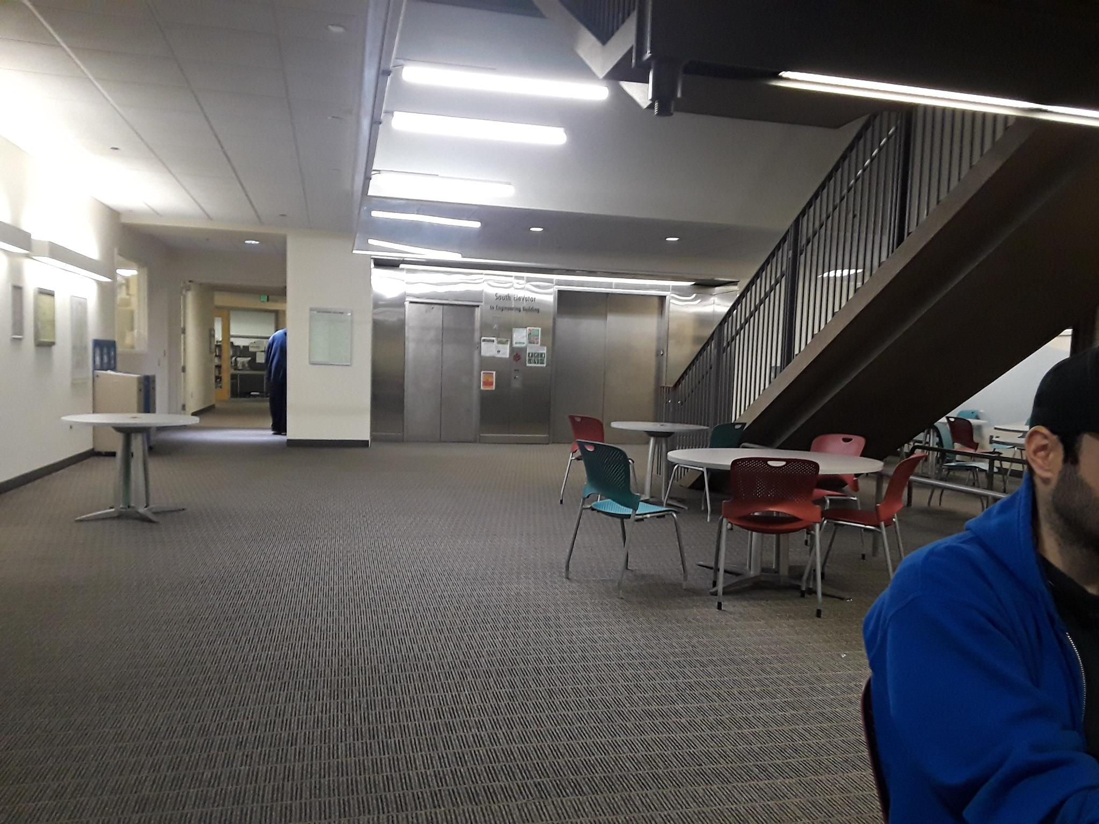
Setup
Location: EB basement lobby.
Target distance: 12 m
Adjacent wall distance: 9 m
Signal originated from laptop speakers
Minimum resolvable distance: 6 m

Slide 3
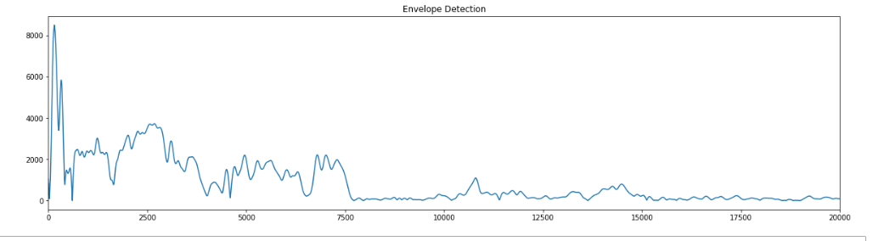
Results: Enveloping
Frequency: 2024 Hz
Number of samples: 10
PW: 14.5 ms (30 Cycles)
Return Detected at 9.7m
Measured Distance 12m

Slide 4
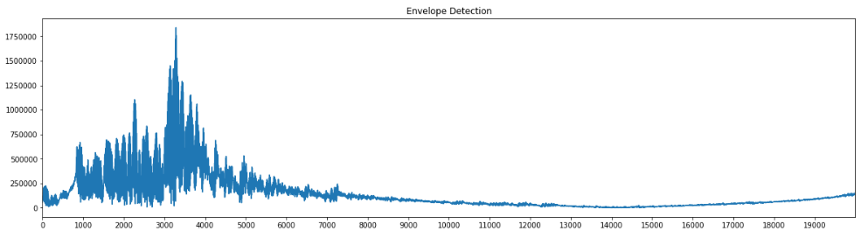
Results: FM Chirp
Signal sweep from 2024 Hz to 4048 Hz
Number of samples: 10
PW: 29.6 ms
Return Detected at 13.2 m
Distance measures at 12 m

Slide 5
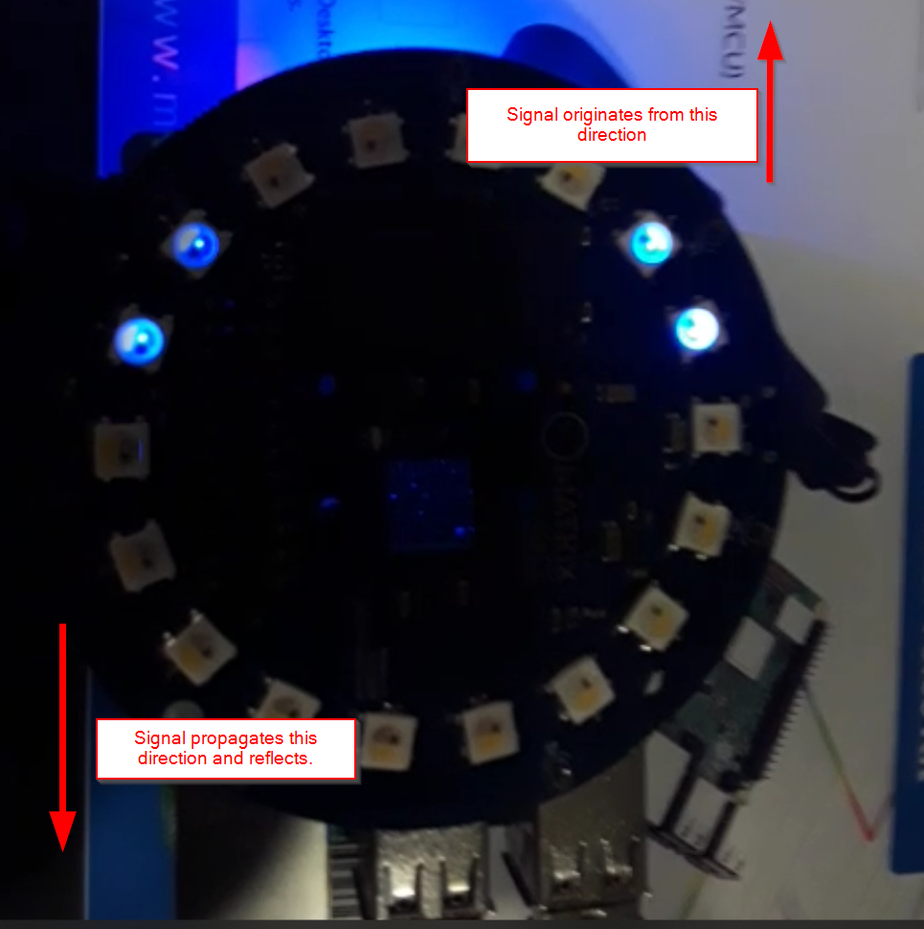
Angle of Arrival
Tested in hallway adjacent to EB basement lobby.
Used open sourced library ODAS library to estimate angle of arrival
ODAS originally used to determine source of nearby sound.
Original code filters out signals below a certain threshold to determine loudest sound.
Modified code to filter out sounds larger than a certain threshold.
LEDs light up in direction of returned signal.

Slide 6
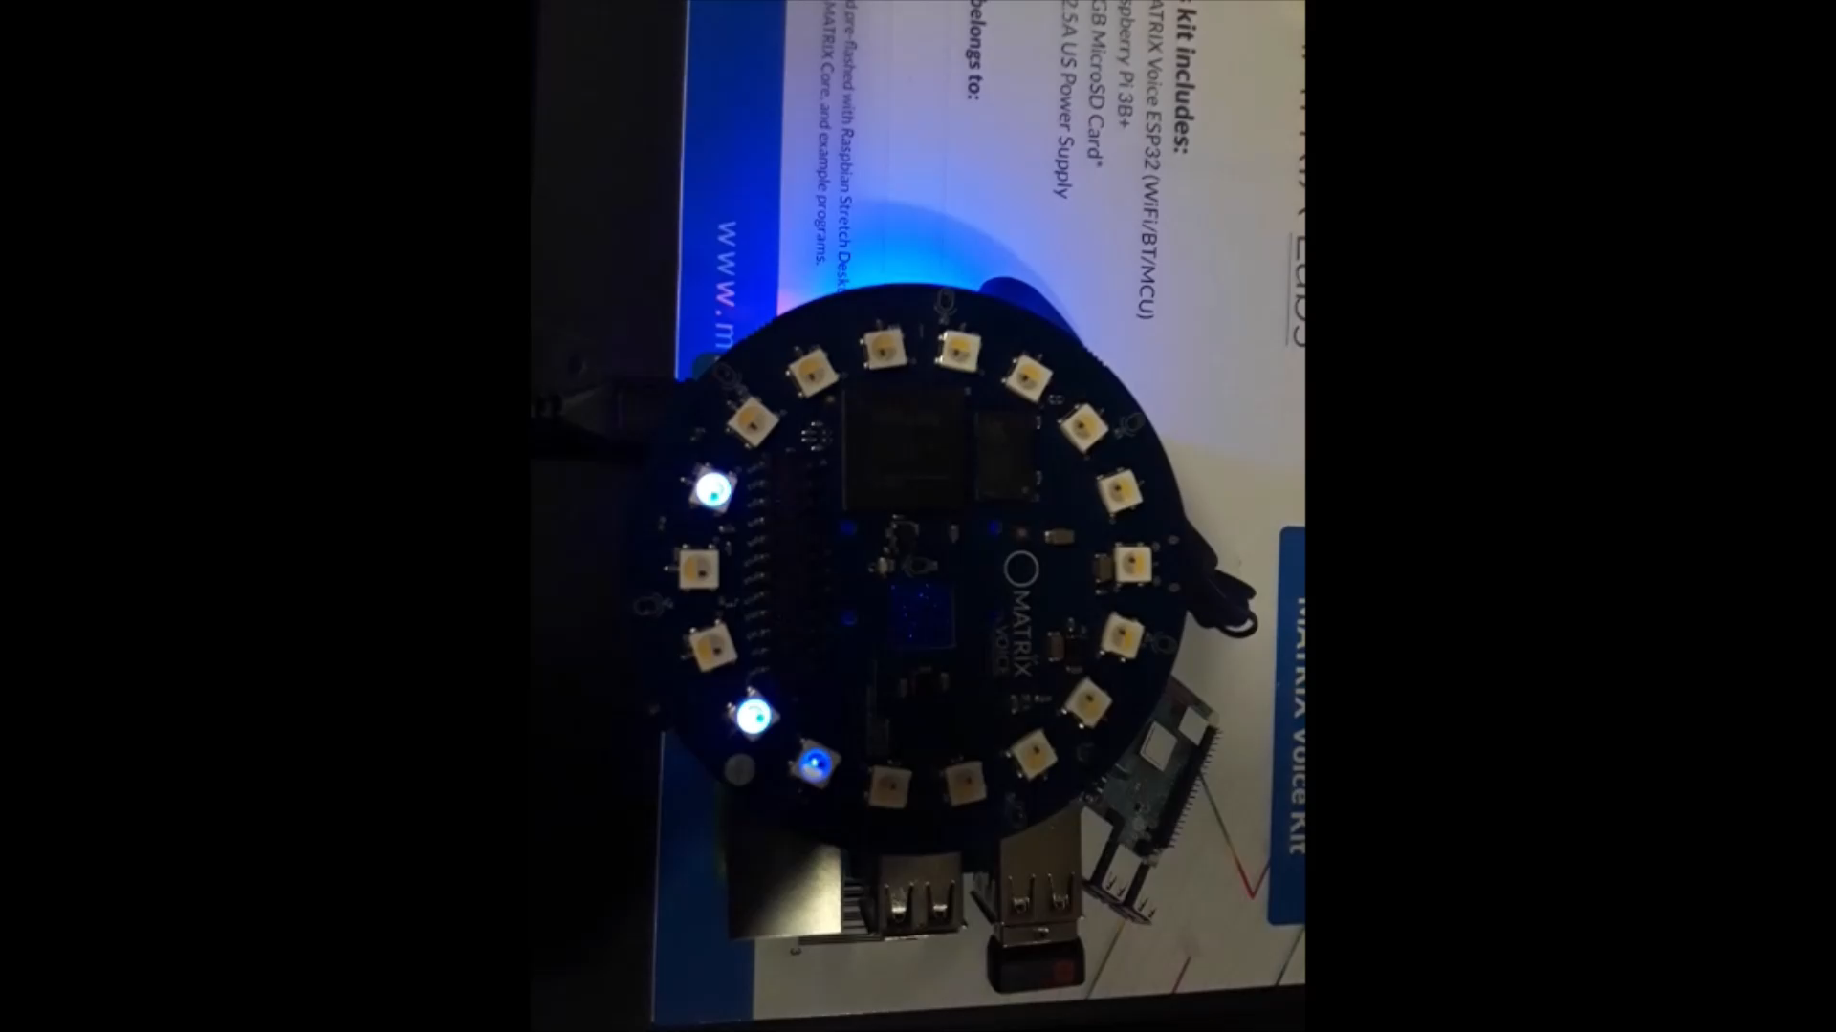
Angle of Arrival
LEDs sweep as signal reflected off the walls to the left and right.
Location had HVAC fans running, the sound of which was picked up by the Matrix.
Decreasing microphone sensitivity likely would improve results

